Slide 1
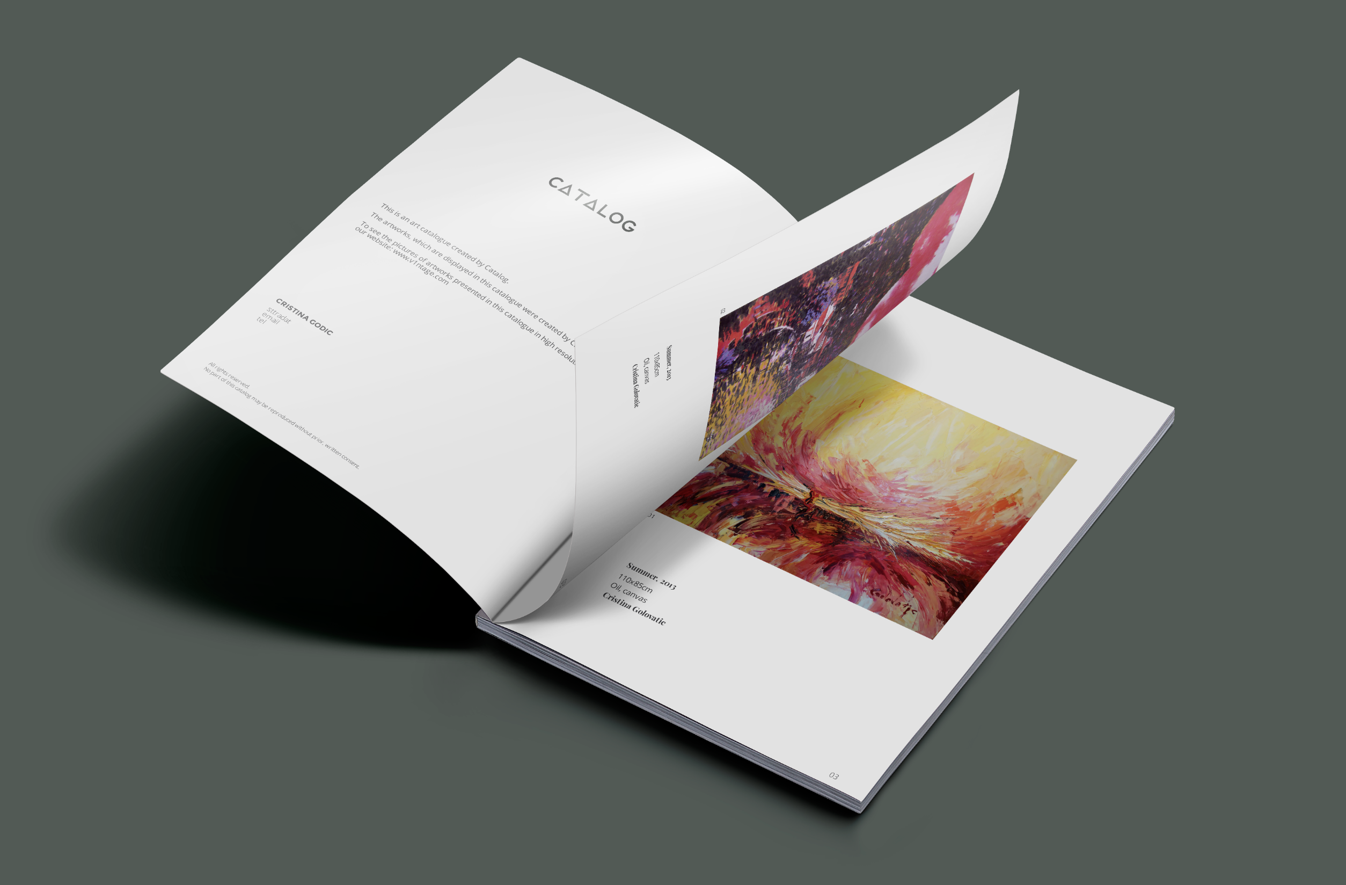

Slide 2

Notes:
We are happy to present you Catalog. In the course of last 48 hours, my team did an amazing job creating this new product, which we will show a demo of. Thank you team!

Slide 3
Artists are terrible designers
Notes:
You see, in my experience I learned an important truth, that Artists are terrible designers. They are bad in making brochures, catalogues, price tags, business card, flyers. Not only they are bad, they are super bad. So why not to create machine to do that for them and just make them happy. We contacted yesterday a dozen of local and international artists and asked if they would use a tool that makes every print material automatically, they told me that they absolutely loved the idea. Most of them asked us to bring some new features, to make it simple, less customization.

Slide 4
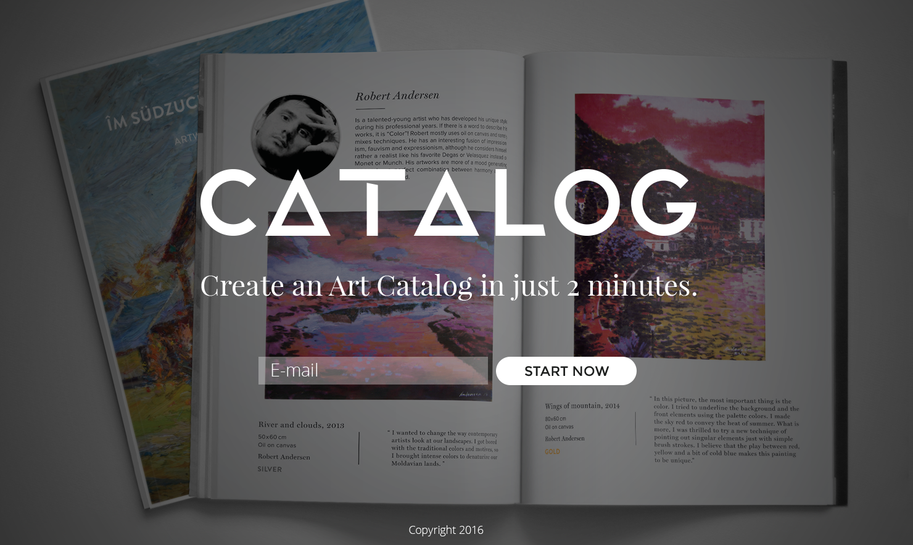

Slide 5
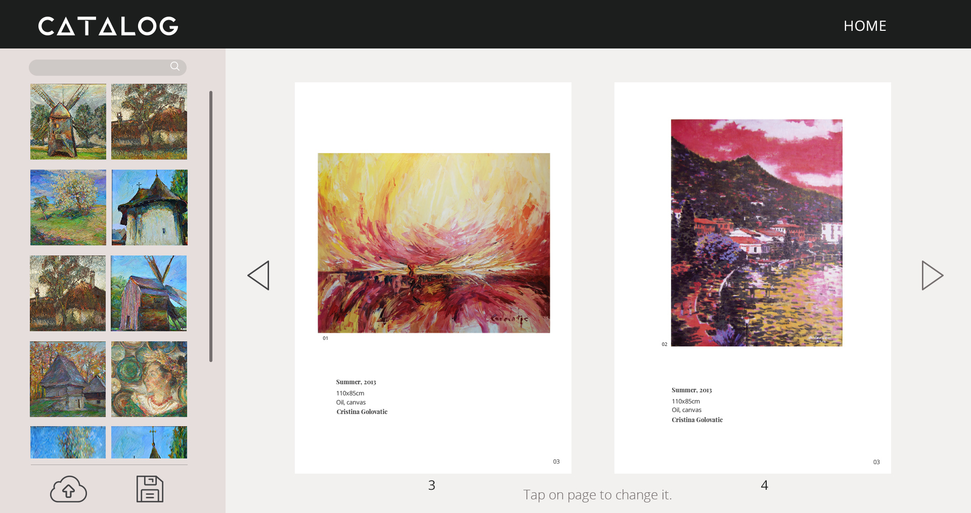

Slide 6
Simplicity is the ultimate complexity.
Notes:
Now, you probably ask yourself, what is so revolutionary regarding this product and how we gonna make money? It is just a pdf creator, isn’t it?

Slide 7
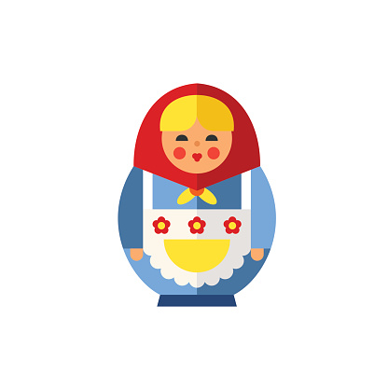

Design Tool
C- Mixbook
$ - Gallery Catalogs
G – Artists ☺
M – 40 mln $
S - Supply
E-commerce
C- Artsy; Saatchi
$ - Sale Comission
G – Collectors ☺
M – 6 bln $
S - Demand
Investment Market
C- Sotheby’s, Christies,
$ - Re-Sale Comission
G – Investors ☺
M – 51 bln $
2016
2017
2019
Notes:
Not really, it is small part of a much bigger vision.

Slide 8
Design Tool
50$/file created
E-commerce
12% sale comission
Investment Market
5% resale comission

Slide 9
